Slide 1
Alarm System
July 2026
Kay Kasemir

Slide 2
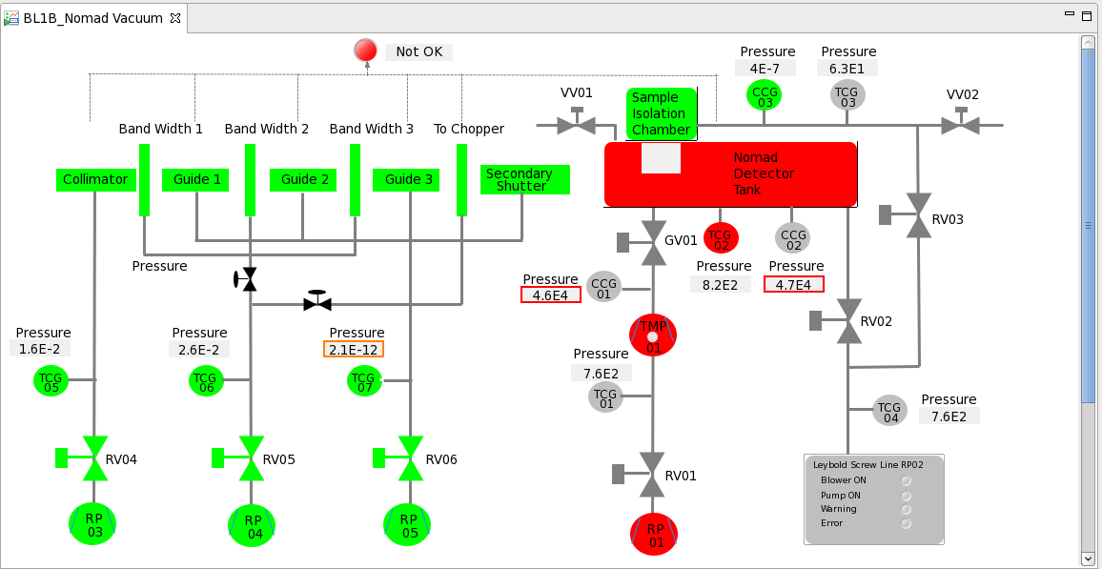
EPICS PVs carry Values with Alarm Information
No alarm, MINOR, MAJOR
  Analog records:
  LOLO, LOW, HIGH, HIHI limits
  Binary records:
  0 or 1 state may alarm
Display Tools
  Typically indicate alarm state via border and/or color
IOC 1
IOC 2
PV
VAL: 10
HIGH: 5
HSV: MINOR
PV
VAL: 20
HIHI: 20
HHSV: MAJOR

Slide 3

Alarm Fields in EPICS Records
# bi, bo﻿
record(bi, "binary")
{
# Alarm states
field(ZSV, "MINOR")
field(OSV, "MAJOR")
# Display niceties
field(ZNAM, "Marginal")
field(ONAM, "Hopeless")
}
﻿record(mbbi, "states")
{
# Alarm states
field(TWSV, "MAJOR")
# Display niceties
field(ZRST, "Off")
field(ONST, "On")
field(TWST, "Overheated")
}
/ics/examples/22_alarms/alarms.db and alarms.bob

Slide 4


Alarm Fields in EPICS Records
# ai, ao, calc, calcout, longin, longout, …﻿
record(ai, "analog")
{
# Alarm limits
field(HIHI, "100")
field(HHSV, "MAJOR")
field(HIGH, "80")
field(HSV, "MINOR")
field(LOW, "20")
field(LSV, "MINOR")
field(LOLO, "0")
field(LLSV, "MAJOR")
# Alarm hysteresis
field(HYST, "5")
# Display niceties
field(HOPR, "110")
field(LOPR, "-10")
field(EGU, "Fathoms")
field(PREC, "1")
}
For historic reasons, need to set both
one or more alarm threshold
corresponding severity
/ics/examples/22_alarms/alarms.db and alarms.bob

Slide 5
Alarm Fields in EPICS Records
Perfectly fine
Don’t do this
record(ai, ”only_hihi")
{
field(HIHI, ”100")
field(HHSV, ”MAJOR")
}
record(ai, ”only_high")
{
field(HIGH, "80")
field(HSV, "MINOR")
}
record(ai, ”only_low")
{
field(LOW, ”10")
field(LSV, "MINOR")
}
record(ai, ”high_as_hihi")
{
field(HIGH, ”100")
field(HSV, ”MAJOR")
}
record(ai, ”odd_order")
{
field(HIHI, ”100")
field(HHSV, "MINOR")
field(HIGH, "80")
field(HSV, ”MAJOR")
}
/ics/examples/22_alarms/alarms.db and alarms.bob

Slide 6
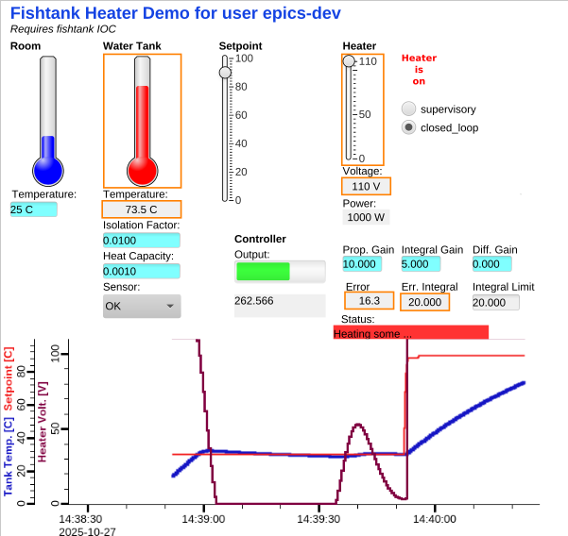
Fishtank
Is tank temperature
above 70 C or below 0 C a good alarm?
Is heater at
110 V a good alarm?
/ics/examples/fishtank: st.cmd, heater.bob

Slide 7
EPICS PVs carry Values with Alarm Information
No alarm, MINOR, MAJOR
  Analog records:
  LOLO, LOW, HIGH, HIHI limits
  Binary records:
  0 or 1 state may alarm
Display Tools
  Indicate alarm state via border
What if nobody is looking at the screen at the time?
IOC 1
IOC 2
PV
VAL: 10
HIGH: 5
HSV: MINOR
PV
VAL: 20
HIHI: 20
HHSV: MAJOR

Slide 8
Alarm System Idea
Alarm System
Indicate alarms:
Which PV? When? What value?..
Guidance
Related Displays
Keep alarms until
acknowledged & cleared
“Check XYZ.
Try opening ABC.
Call Fred.”
PV
VAL: 10
HIGH: 5
HSV: MINOR
PV
VAL: 20
HIHI: 20
HHSV: MAJOR

Slide 9
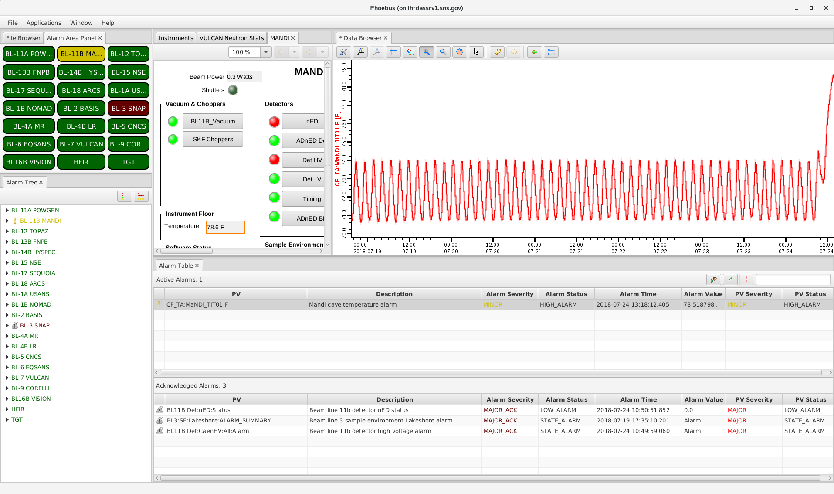
Implementation
CS-Studio Alarm UI
Apache Kafka
Alarm Configuration
- Which PVs to monitor
- Guidance
- Display Links
Current State
- Which PVs are in alarm?
Alarm Server
Monitors PVs,
updates current state
PV
PV
PV
PV
For details of implementation, see CS-Studio Alarm System Based on Kafka,
https://accelconf.web.cern.ch/icalepcs2019/papers/wesh2001.pdf

Slide 10
Initial Setup
https://github.com/ControlSystemStudio/phoebus/blob/master/app/alarm
Install Kafka (typically as Linux service)
Check that “Accelerator” config exists
cd /ics/tools
systemctl status kafka
./monitor_topics.sh Accelerator
Start alarm server (typically also as Linux service)
alarm-server

Slide 11
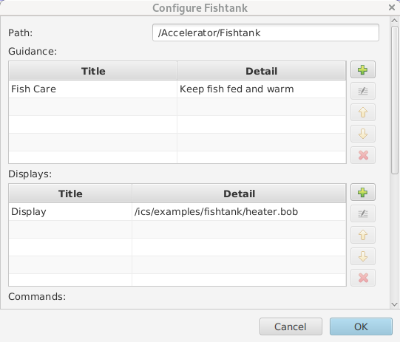
Configuration for ‘Fishtank’
Open CS-Studio Applications, Alarm, Alarm Tree
Find component “Fishtank”
  Check Guidance and Display link

Slide 12
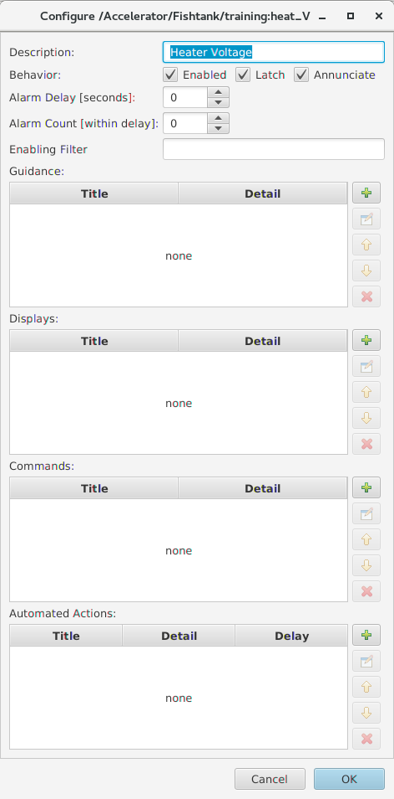
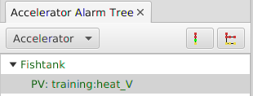
Configuration Example
Right-click on “Fishtank”, Add Component
  PV “training:heat_V”
  Description
    Anything’s better than the PV name
  Specific Guidance and Displays
    Should have guidance. Otherwise, why is this an alarm?
  Enabled? Latch? Annunciate?
    Usually: Yes, otherwise: Why bother?
  Delay?
    Hack for noisy alarm trigger PVs
  Automated Actions
    mailto:fred@google.com

Slide 13
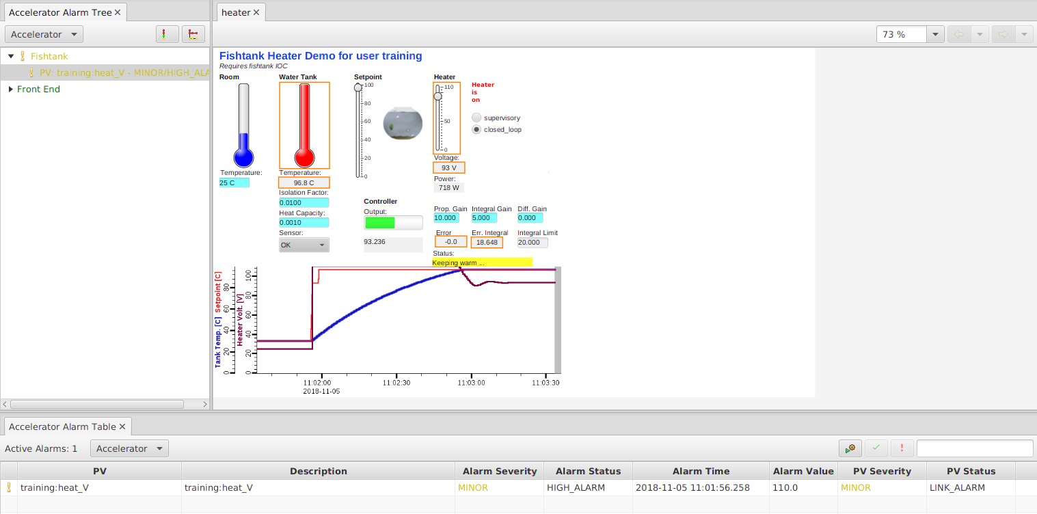
Example Alarm Workflow
Suggested “Alarm” layout:
Alarm Tree to the left,
Alarm Table at the bottom,
both “locked”
Cause an alarm
  caput epics-dev:setpoint 72
Inspect Alarm
  Watch as alarm
  is indicated
  Open associated
  display
Handle It
  Acknowledge
  Reduce setpoint
  → Clear

Slide 14
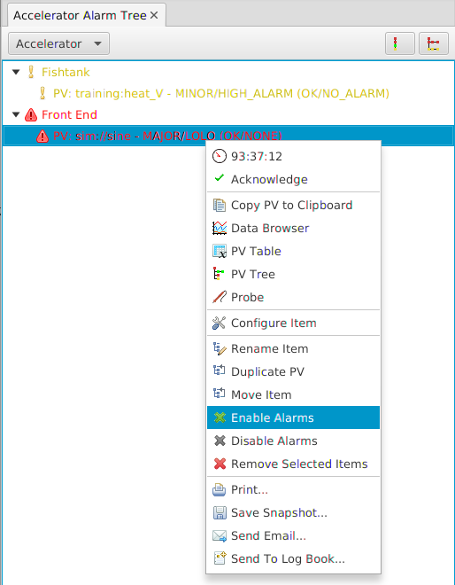
Alarm Tree
Primary configuration tool
Hierarchical
  Guidance, Displays apply to sub-nodes
Operational useful to
  Check if numerous alarms originate in the same area
  Acknowledge or disable complete subtrees

Slide 15
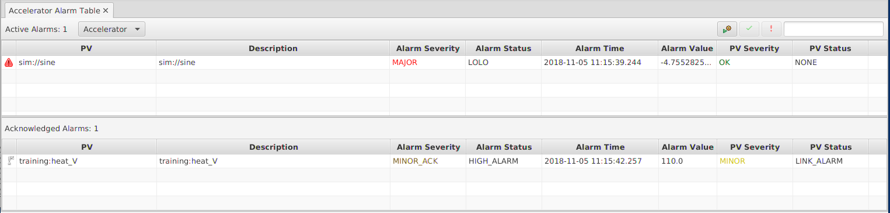
Alarm Table
Primary operations tool
Ideally empty
View/sort/acknowledge alarms
Open guidance and displays

Slide 16
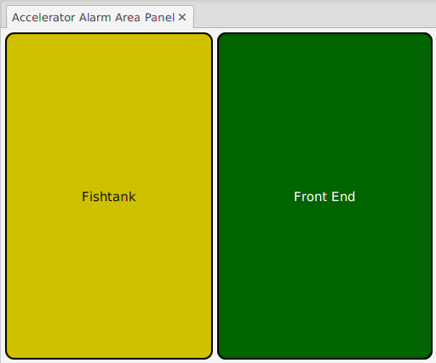
Alarm Area Panel
Useful for ‘Overview Displays’
Indicates
‘across the room’:
All OK?

Slide 17
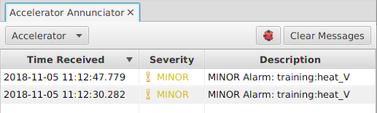
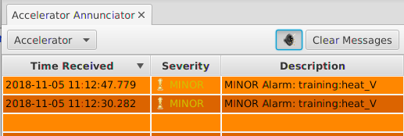
Alarm Annunciator
Annunciates the description of alarms
Basic “heads up” to check alarm table for details

Slide 18
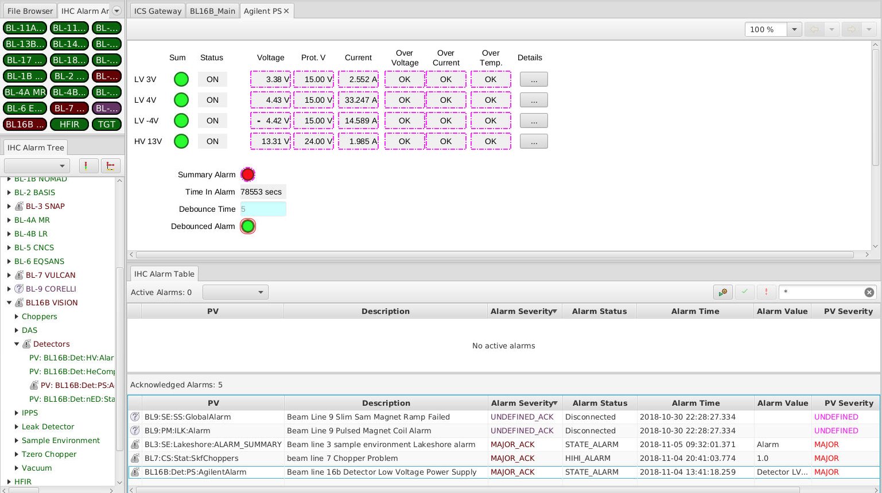
Basic Roles
System Expert
  Provide useful alarm levels
  Explain what to to when alarm happens
Control System Engineer
  Configure alarm levels
  Maybe create new alarm trigger PV
  Create displays
Operations Expert
  Add alarm trigger PV to alarm system,
  with guidance and links to displays
Operators
  Handle alarms, helped by guidance

Slide 19
Alarm System
Alarm Server monitors PVs, tracks alarms
Alarm Tree to configure
  PV?
  Guidance?
  Displays?
Alarm Table,
Area Panel,
Annunciator
to use
  Acknowledge
  Open Displays
Suggested Layout with
“locked” alarm panels

